Slide 1
60-322
Object-Oriented Analysis and Design
Mar 2, 2009

Slide 2
Chapter 17
Grasp: Design Objects with Responsibilities
Understanding responsibilities is key to good object-oriented design.

Slide 3
Ch. 17 GRASP
We are finally at the chapter discussing object-oriented design.
The principle for OOD – RDD (Responsibility-driven Design)
The GRASP? What is it?
  A methodical approach to basic OOD.
  A learning aid for OOD with Responsibilities
  It is a set of principles and patterns to help us understand essential object design and apply design reasoning in a methodical, rational, explainable way.

Slide 4
Ch. 17 GRASP
What is involved in OOD?
  After identifying your requirements and creating a domain model, then
    add methods to the appropriate classes, and
    define the messaging between the objects to fulfill the requirements.
How to do OOD?
  Study OOD principles and patterns
  Examples help
  Practice helps.
  The process involves a large set of soft principles, with many degrees of freedom.

Slide 5
Ch. 17 GRASP
Before we delve into OOD.
The big picture
  What's been done? Prior activities (e.g., workshop) and artifacts.
  How do things relate? Influence of prior artifacts (e.g., use cases) on OO design.
  How much design modeling to do, and how?
  What's the output?

Slide 6
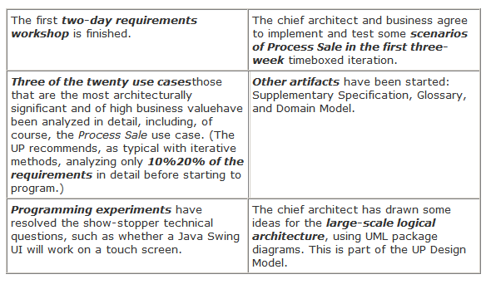
What are inputs to OOD?
Assume we are developers working on the NextGen POS project, and the following scenario has happened:

Slide 7
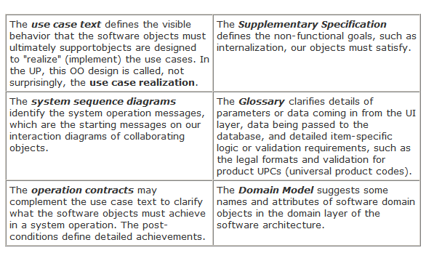
What are inputs to OOD?

Slide 8
What are activities of Object Design?
Given the inputs, developers
1) start immediately coding (ideally with test-first development),
2) start some UML modeling for the object design, or
3) start with another modeling technique, such as CRC cards

Slide 9
What are activities of Object Design?
In the UML case, we draw both interaction diagrams and complementary class diagrams (dynamic and static modeling) during one modeling day.
And most importantly, during the drawing (and coding) activity we apply various OO design principles, such as GRASP (Ch. 17) and the Gang-of-Four (GoF) (Ch. 26) design patterns.
The overall approach to doing the OO design modeling will be based on the metaphor of responsibility-driven design (RDD), thinking about how to assign responsibilities to collaborating objects.

Slide 10
What are activities of Object Design?
Imagine the following scenario of OOD activities:
On the modeling day, perhaps the team works in small groups for 2-6 hours either at the walls or with software modeling tools, doing different kinds of modeling for the difficult, creative parts of the design. This could include UI, OO, and database modeling with UML drawings, prototyping tools, sketches, and so forth.

Slide 11
What are activities of Object Design?
During UML drawing, we adopt the realistic attitude (also promoted in agile modeling) that we are drawing the models primarily to understand and communicate, not to document. Of course, we expect some of the UML diagrams to be useful input to the definition (or automated code generation with a UML tool) of the code.
On Tuesday-still early in the three-week timeboxed iteration-the team stops modeling and puts on programmer hats to avoid a waterfall mentality of over-modeling before programming.

Slide 12
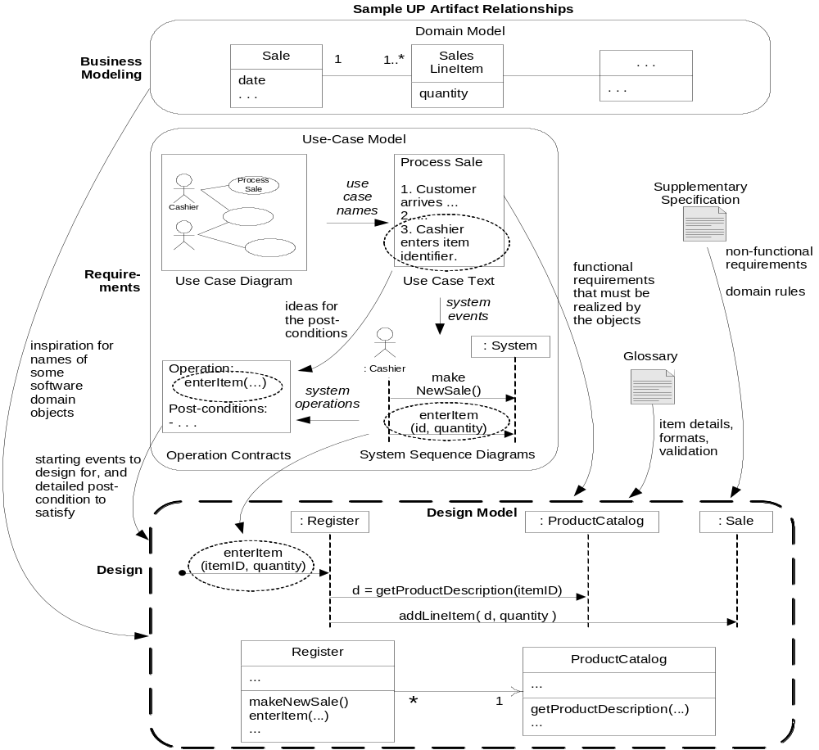
What are the outputs of OOD?

Slide 13
What are the outputs of OOD?
What's been created during the modeling day (for example)?
  specifically for object design, UML interaction, class, and package diagrams for the difficult parts of the design that we wished to explore before coding.
  UI sketches and prototypes
  database models (with UML data modeling profile notation)
  report sketches and prototypes

Slide 14
RDD
A popular way of thinking about the design of software objects and also larger-scale components is in terms of
  responsibilities,
  roles, and
  collaborations.
This is part of a larger approach called Responsibility-Driven Design or RDD

Slide 15
RDD
In RDD, we think of software objects as having responsibilities - an abstraction of what they do.
Responsibilities are related to the obligations or behavior of an object in terms of its role.
Basically, these responsibilities are of the following two types:
  Doing
  Knowing.

Slide 16
RDD
Doing responsibilities of an object include:
  doing something itself, such as creating an object or doing a calculation
  initiating action in other objects
  controlling and coordinating activities in other objects

Slide 17
RDD
Knowing responsibilities of an object include:
  knowing about private encapsulated data
  knowing about related objects
  knowing about things it can derive or calculate

Slide 18
RDD
Guideline:
For software domain objects, the domain model, because of the attributes and associations it illustrates, often inspires the relevant responsibilities related to "knowing."
    For example, if the domain model Sale class has a time attribute, it's natural by the goal of low representational gap that a software Sale class knows its time.
A responsibility is not the same thing as a method - it's an abstraction - but methods fulfill responsibilities.
The translation of responsibilities into classes and methods is influenced by the granularity of the responsibility.

Slide 19
RDD
RDD also includes the idea of collaboration. Responsibilities are implemented by means of methods that either act alone or collaborate with other methods and objects.
    For example, the Sale class might define one or more methods to know its total; say, a method named getTotal. To fulfill that responsibility, the Sale may collaborate with other objects, such as sending a getSubtotal message to each SalesLineItem object asking for its subtotal.

Slide 20
RDD
RDD is a general metaphor for thinking about OO software design. Think of software objects as similar to people with responsibilities who collaborate with other people to get work done.
RDD leads to viewing an OO design as a community of collaborating responsible objects.
Key point: GRASP names and describes some basic principles to assign responsibilities, so it's useful to know - to support RDD.

Slide 21
GRASP: A Methodical Approach to Basic OO Design
It is possible to name and explain the detailed principles and reasoning required to grasp basic object design, assigning responsibilities to objects.
The GRASP principles or patterns are a learning aid to help you understand essential object design and apply design reasoning in a methodical, rational, explainable way.
This approach to understanding and using design principles is based on patterns of assigning responsibilities.

Slide 22
GRASP: A Methodical Approach to Basic OO Design
This chapter and several others uses GRASP as a tool to help master the basics of OOD and understanding responsibility assignment in object design.
Understanding how to apply GRASP for object design is a key goal of the book.
So, GRASP is relevant, but on the other hand, it's just a learning aid to structure and name the principles, once you "grasp" the fundamentals, the specific GRASP terms (Information Expert, Creator, …) aren't important.

Slide 23
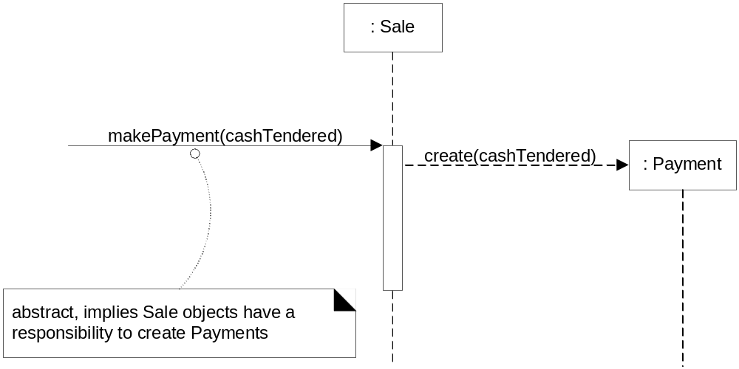
Responsibilities, GRASP, and UML
You can think about assigning responsibilities to objects while coding or while modeling.
Within the UML, drawing interaction diagrams becomes the occasion for considering these responsibilities (realized as methods).

Slide 24
Responsibilities, GRASP, and UML
The figure indicates that Sale objects have been given a responsibility to create Payments, which is concretely invoked with a makePayment message and handled with a corresponding makePayment method.
Furthermore, the fulfillment of this responsibility requires collaboration to create the Payment object and invoke its constructor.

Slide 25
Responsibilities, GRASP, and UML
Therefore, when we draw a UML interaction diagram, we are deciding on responsibility assignments.
This chapter emphasizes fundamental principles - expressed in GRASP - to guide choices about assigning responsibilities.
Thus, you can apply the GRASP principles while drawing UML interaction diagrams, and also while coding.

Slide 26
Patterns
Experienced OO developers (and other software developers) build up a repertoire of both general principles and idiomatic solutions that guide them in the creation of software.
These principles and idioms, if codified in a structured format describing the problem and solution and named, may be called patterns.
For example, here is a sample pattern:

Slide 27
Patterns
Pattern Name:
  Information Expert
Problem:
  What is a basic principle by which to assign responsibilities to objects?
Solution:
  Assign a responsibility to the class that has the information needed to fulfill it.

Slide 28
Patterns
In OO design, a pattern is a named description of a problem and solution that can be applied to new contexts;
ideally, a pattern advises us on how to apply its solution in varying circumstances and considers the forces and trade-offs.
Many patterns, given a specific category of problem, guide the assignment of responsibilities to objects.

Slide 29
New Patterns?
New pattern should be considered an oxymoron if it describes a new idea. The very term "pattern" suggests a long-repeating thing.
The point of design patterns is not to express new design ideas. Quite the opposite - great patterns attempt to codify existing tried-and-true knowledge, idioms, and principles; the more honed, old, and widely used, the better.
Consequently, the GRASP patterns don't state new ideas; they name and codify widely used basic principles. To an OO design expert, the GRASP patterns by idea if not by name will appear fundamental and familiar.

Slide 30
The Gang-of-Four Design Patterns Book
The idea of named patterns in software comes from Kent Beck (also of Extreme Programming fame) in the mid 1980s.
1994 was a major milestone in the history of patterns, OO design, and software design books: The massive-selling and hugely influential book Design Patterns was published, authored by Gamma, Helm, Johnson, and Vlissides.

Slide 31
The Gang-of-Four Design Patterns Book
The book, considered the "Bible" of design pattern books, describes 23 patterns for OO design, with names such as Strategy and Adapter.
These 23 patterns, authored by four people, are therefore called the Gang of Four (or GoF) design patterns.
It is a key goal of this text to learn both GRASP and essential GoF patterns. (Ch. 17, 26, 36, 37)

Slide 32
Where are we now?
So far, this chapter has summarized the background for OO design:
  The iterative process background - Prior artifacts? How do they relate to OO design models? How much time should we spend design modeling?
  RDD as a metaphor for object design - a community of collaborating responsible objects.
  Patterns as a way to name and explain OO design ideas - GRASP for basic patterns of assigning responsibilities, and GoF for more advanced design ideas. Patterns can be applied during modeling and during coding.
  UML for OO design visual modeling, during which time both GRASP and GoF patterns can be applied.
With that understood, it's time to focus on some details of object design.

Slide 33
A short Example of OOD with GRASP
let's start with a shorter example to see the big ideas, applied to the Monopoly case study.
There are nine GRASP patterns; this example applies the following subset:
  Creator
  Information Expert
  Low Coupling
  Controller
  High Cohesion

Slide 34
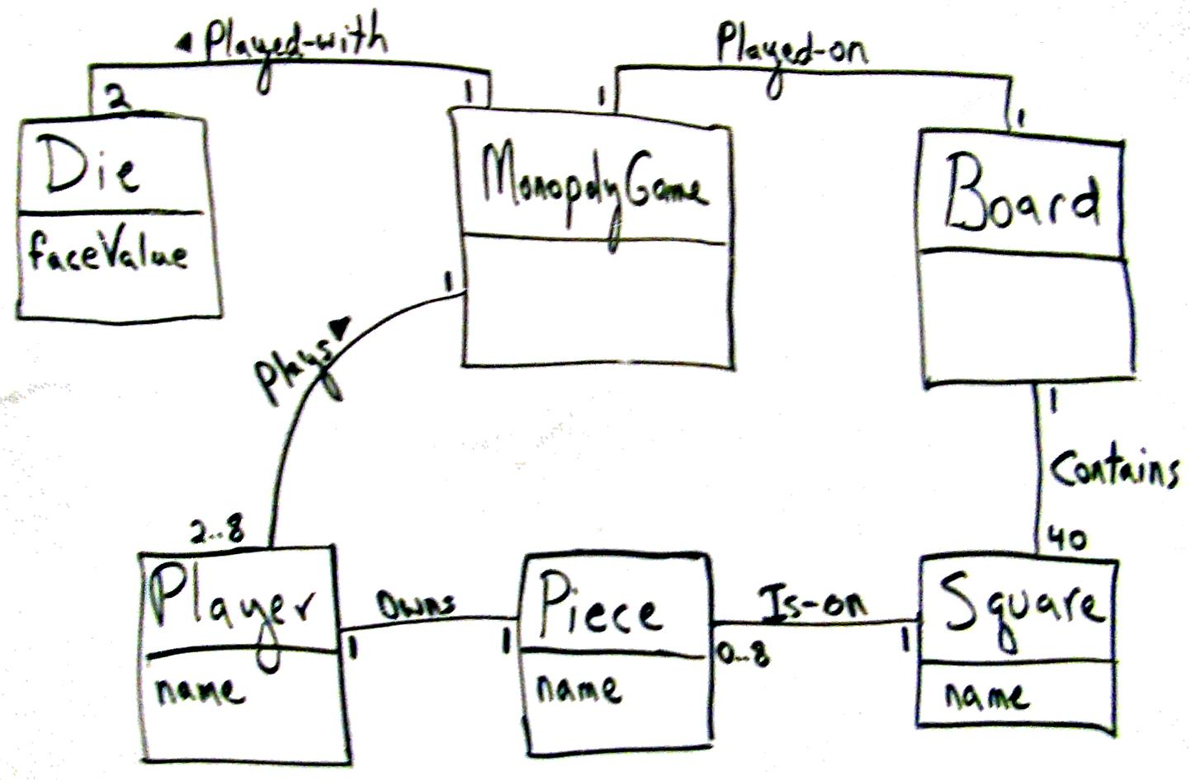
A short Example of OOD with GRASP

Slide 35
GRASP: Creator
Creator
Problem: Who creates the Square object?
One of the first problems you have to consider in OO design is:
  Who creates object X?
This is a doing responsibility.
  For example, in the Monopoly case study, who creates a Square software object? Now, any object can create a Square, but what would many OO developers choose? And why? How about a Dog object to create a Square object?

Slide 36
GRASP: Creator
Definition of the Creator pattern
Name: Creator
Problem: Who creates an A?
Solution: (this can be viewed as advice)
  Assign class B the responsibility to create an instance of class A if one of these is true (the more the better):
    B "contains" or compositely aggregates A.
    B records A.
    B closely uses A.
    B has the initializing data for A.

Slide 37
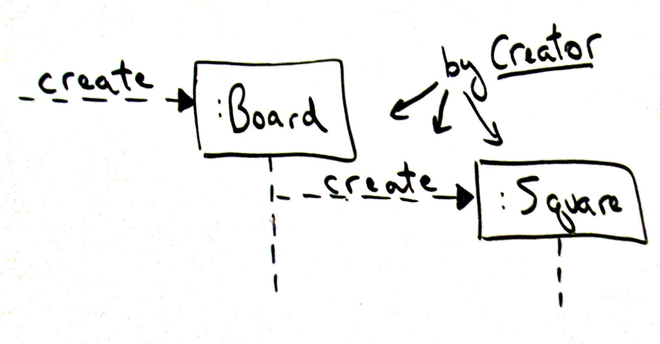
GRASP: Creator

Slide 38
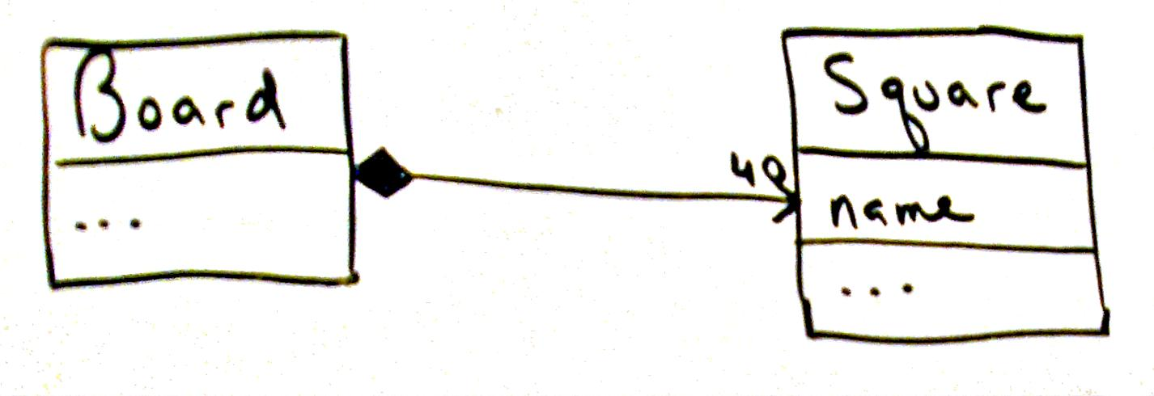
GRASP: Creator

Slide 39
GRASP: Information Expert
Information Expert
Problem: Who knows about a Square object, given a key?
The pattern Information Expert (often abbreviated to Expert) is one of the most basic responsibility assignment principles in object design.
Suppose objects need to be able to reference a particular Square, given its name. Who should be responsible for knowing a Square, given a key? Of course, this is a knowing responsibility, but Expert also applies to doing.
Board object? Why? What’s the pattern here?

Slide 40
GRASP: Information Expert
Information Expert explains why the Board is chosen:
Name: Information Expert
Problem: What is a basic principle by which to assign responsibilities to objects?
Solution: (advice)
Assign a responsibility to the class that has the information needed to fulfill it.

Slide 41
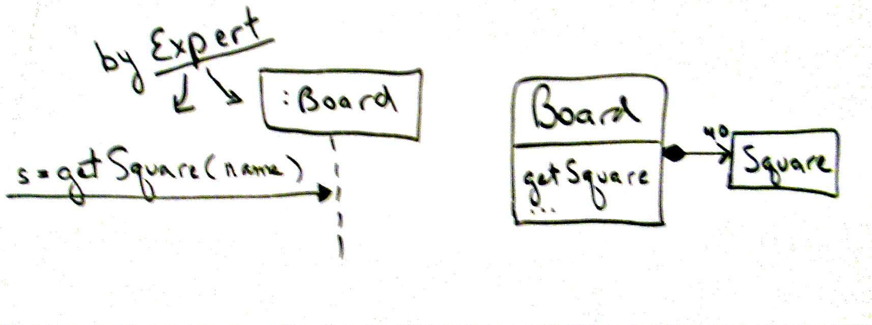
GRASP: Information Expert

Slide 42
GRASP: Low coupling (Explains the Question: Why Board over Dog? )
(Information) Expert guides us to assign the responsibility to know a particular Square, given a unique name, to the Board object because the Board knows about all the Squares (it has the information - it is the Information Expert). But why does Expert give this advice?
The answer is found in the principle of Low Coupling.

Slide 43
GRASP: Low coupling (Explains the Question: Why Board over Dog? )
Briefly and informally, coupling is a measure of how strongly one element is connected to, has knowledge of, or depends on other elements.
If there is coupling or dependency, then when the depended-upon element changes, the dependant may be affected.
  For example, a subclass is strongly coupled to a superclass.
  An object A that calls on the operations of object B has coupling to B's services.

Slide 44
GRASP: Low coupling (Explains the Question: Why Board over Dog? )
The Low Coupling principle applies to many dimensions of software development; it's really one of the cardinal goals in building software.
In terms of object design and responsibilities, we can describe the advice as follows:
  Name: Low Coupling
  Problem: How to reduce the impact of change?
  Solution: (advice)
    Assign responsibilities so that (unnecessary) coupling remains low. Use this principle to evaluate alternatives.

Slide 45
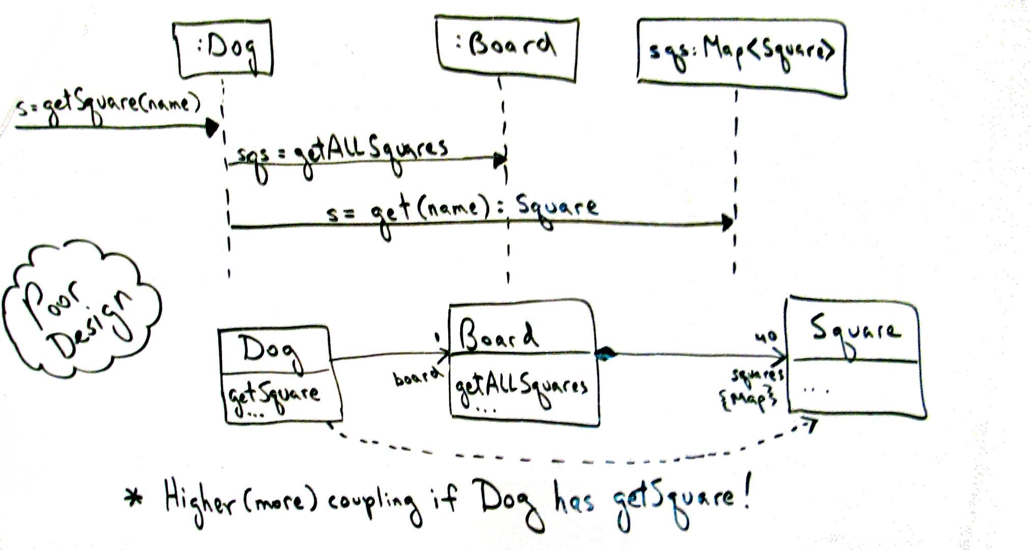
GRASP: Low coupling (Explains the Question: Why Board over Dog? )

Slide 47
GRASP: Low coupling (Explains the Question: Why Board over Dog? )
Why is Low Coupling desirable? In other words, why would we want to reduce the impact of change?
Because Low Coupling tends to reduce the time, effort, and defects in modifying software. That's a short answer, but one with big implications in building and maintaining software!

Slide 48
GRASP: Low coupling (Explains the Question: Why Board over Dog? )
Key Point: Expert Supports Low Coupling
To return to the motivation for Information Expert: it guides us to a choice that supports Low Coupling. Expert asks us to find the object that has most of the information required for the responsibility (e.g., Board) and assign responsibility there.
If we put the responsibility anywhere else (e.g., Dog), the overall coupling will be higher because more information or objects must be shared away from their original source or home, as the squares in the Map collection had to be shared with the Dog, away from their home in the Board.

